Slide 1



Exhibitor and Sponsor Prospectus

Slide 2
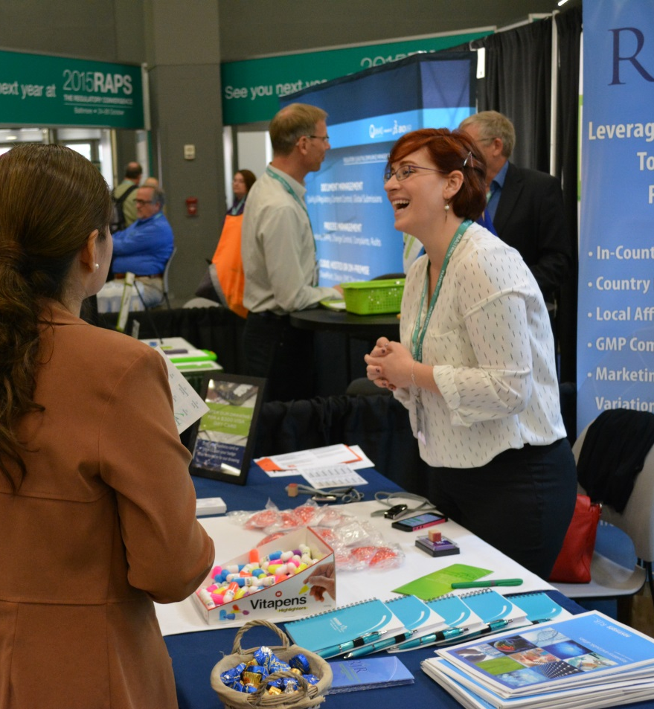
Prospectus Contents
RAPS Regulatory Convergence
Attendee Profile
Exhibitor and Sponsor Profile
Past Exhibitors
Testimonials
Sponsorship Opportunities
Exhibit Fees and Floorplan
Additional Information
Important Deadlines
Contact Us
Notes:
Lots of show pictures will be added

Slide 3
Welcome to Your Regulatory Meeting Place
The Regulatory Affairs Professionals Society (RAPS) delivers the largest, most engaged community for regulatory professionals—RAPS Regulatory Convergence.
Convergence is a premier event for access to more than 2,000 regulatory professionals working in the medical device, pharmaceutical and biotech industries. In addition to working in submissions and compliance, our attendees play integral roles in every stage of the healthcare product lifecycle including development, distribution, marketing and post-market surveillance.
Convergence delivers focused learning, visionary road-maps and optimal networking with like-minded professionals.
Notes:
Include attendance charts

Slide 4
Welcome to Your Regulatory Meeting Place
Engage with Customers
Build New Business
Demonstrate Expertise
Convergence is an effective way to strengthen business relationships, recruit regulatory talent and showcase your products and services.
Networking is a top priority for attendees and RAPS Regulatory Convergence is designed to maximize opportunities to connect with key decision-makers, develop new relationships and generate awareness of your brand.
Help attendees navigate the complexities of today’s global regulatory landscape by demonstrating your expertise and solutions.
Notes:
Smart Art / info graphic

Slide 5
Attendee Profile
Convergence is the premier event for access to regulatory professionals working in the medical device, pharmaceutical and biotech industries. In addition to working in submissions and compliance, they play integral roles in every stage of the healthcare product lifecycle including development, distribution, marketing and post-market surveillance.
Nearly half of our 2018 attendees visited the Regulatory Convergence for the first time!
Add charts

Slide 6
Exhibitor and Sponsor Profile
Over 130 companies across multiple industries exhibit at Convergence, making it the largest gathering of partners and suppliers for the regulatory affairs community.
Consultants CRO’s Notified Bodies Translation Services | Regulatory Intelligence Compliance/Regulatory Software Talent Acquisition Training

Slide 7
2018 RAPS CONVERGENCE EXHIBITING COMPANIES
3D Communications | CSL Behring | Intertek Scientific & Regulatory Consultancy | Northeastern University | Right Submission
Abbott | Cunesoft GmbH | Intrinsik Corp. | NSAI - National Standards Authority of Ireland | RIMSYS
Accenture | DEKRA Certification | Jazz Pharmaceuticals | NSF Health Sciences | RJR Consulting Inc.
ACUTA LLC | Dora Wirth (Languages) Ltd | KPMG | Oriel STAT A MATRIX | SDSU, Regulatory Science Programs
ALKU | Dr. Knoell Consult | Leidos | Pacific Bridge Medical | Schlafender Hase Inc.
Altria Client Services | EMD Serono, Inc. | LICENSALE.COM | PageFreezer Software Inc | SFL Regulatory Affairs & Scientific Communication
American Preclinical Services | Emergo | Lionbridge Technologies Inc. | PAREXEL | SGS North America Inc.
AMPLEXOR | Ennov | Litera Microsystems | Perigord Life Science Artwork Solutions | ShareVault
Andaman Medical | Ente Certificazione Macchine s.r.l. | LORENZ Life Sciences Group | Pharmaceuticals and Medical Devices Agency | Sparta Systems Inc.
Aquila Solutions, LLC | Evidence Partners | LRQA | PharmaLex GmbH | SPharm Inc.
Arbour Group | EXTEDO | MasterControl Inc. | Promedica International | Stericycle ExpertSOLUTIONS
Ascent | Fang Consulting Ltd/Infinity Biomedical | McCarthy Consultant Services Inc. | Purdue University | Stryker
AssurX Inc. | FDA Quality and Regulatory Consultants | MD-Clinicals SA | Qadvis AB | Synchrogenix
AxSource Consulting Inc. | FDAnews / CenterWatch | MED Institute, Inc. | Qserve Group | Synex Consulting, Ltd.
BlueReg Group | Fresenius Kabi USA | MedCert GmbH | RA/QA Graduate Program-Temple University | Tarius
Brandwood Biomedical | Fresenius Medical Care | Medical Device Safety Service GmbH | RaQa Consulting Inc. | The IRISS Forum
Brooke Pro Sound & Vision | G&M Health, LLC | Medical Regulations Gate | Raylytic GmbH | Therapeutic Products Inc
BSI Group America Inc | Generis | Medidee Services SA | RCRI | TUV Rheinland
Cabeus, Inc. | G-MED North America Inc. | Medtronic | Reed Tech | TUV SUD America Inc.
CAPRA | Graematter Inc. | Mid-Link Technology Testing Co., Ltd. | RegDesk Inc. | TUV USA Inc.
Cardinal Health Regulatory Sciences | Green Key Resources | Montrium | RegDocs365 | UL LLC Health Sciences
CCA Inc. | ICON Clinical Research LLC | Morningside Translations | RegIQ Solutions | University of the Sciences in Philadelphia
China Med Device, LLC | Ideagen | NAMSA | Regulatory Compliance Associates Inc. | Vera Rosas
CMMI Institute | Idem Translation Inc. | Navitas Life Sciences | Regxia Inc. | Welocalize Life Sciences
ConvaTec | Intertek | Network Partners | Research Presentation Strategies Inc. | Whitney Consulting Ltd.

Slide 8


“We thought it was the best industry conference we ever attended. We networked for months prior and had wonderful conversations that were warm and collegial.”
“The number of participants was high and more diversified compared to other events. It permitted us to generate more business leads, which turned into clients for 2 leads. Excellent ROI compared to other events.”
“RAPS is the best. I appreciated how everyone seemed to care about educating us regarding Reg Affairs. All staff, attendees, and exhibitors were super friendly and helpful.”
Notes:
We need an update quote from 2018 exhibitor surveys

Slide 9
Sponsorship Opportunities
RAPS offers tiered sponsorship packages, package add-ons and al la carte options to give you more ways to engage with attendees.
Benefits | Premier $15,000 | Executive $8,500 | Platinum $5,500
Sponsor Recognition (Website, On-site Signage and printed program)
Exhibit Booth (offered on space-availability basis)
Complimentary Convergence Passes | 5 Full | 1 Full; 3 expo-only | 1 Full; 3 expo-only
Pre and post attendee list
Program Ad | Full Page | Half Page | Quarter Page
Lead retrieval
Bag insert (sponsor supplied)
Meter Board
One pre-event and one post-event blind email (dates are first come, first served)

Slide 10
Sponsorship Add-Ons
Accelerate your sponsorship with these add-on options
Welcome Reception* | $11,000 |  | Lanyards* | $9,000
Closing Reception | $2,500 |  | Lunch/Breaks* | Contact RAPS
Registration Sponsor* | Contact RAPS |  | Hospitality Space | Contact RAPS
Attendee Lounge* | $15,000 |  | Headshot Café | $8,000
Solution Spotlights | $7,500 |  | Hotel Key Cards | $6,500
Education Track | $3,000 |  | Convergence Photo Prop | Contact RAPS
Mobile App* | $6,500 |  | Attendee Wellness | Contact RAPS
Convergence Notebook* | $9,000/$12,000 |  | Column Wraps | Contact RAPS
Attendee Bag* | $16,000 |  | Convention Banners | Contact RAPS

Slide 11
Sponsorship Add-on Details
Welcome Reception
  More than one thousand attendees fill the Exhibit Hall for the RAPS Annual Reception, making it the social highlight of the conference. Sponsor recognition will be weaved into the theme of the reception and will include signage, company logo on cocktail napkins, the event program and props.
Closing Reception
  Event details to come, please contact RAPS for inquiries.
Registration Sponsor
  Your brand will be incorporated within RAPS overall design as attendees are welcomed into Convergence 2019. All design aspects are subject to RAPS review and approval. Please contact RAPS for inquiries.

Slide 12
Sponsorship Add-on Details
Attendee Lounge
  Located in the middle of the show floor and covering 1,500 square feet, the lounge is at the center of the exhibit hall activity. Your brand is on full display for attendees as they relax and recharge. Sponsorship includes all branding, furniture (includes a tabletop for staff), lead retrieval, refreshment station and massage station. All design aspects are subject to RAPS review and approval.
Solution Spotlights
  Your company will have 45 minutes to share your expertise in front of attendees looking for solutions. RAPS will provide a dedicated space with seating and all AV needs. Sessions will be hosted in the exhibit hall and listed in the conference program for added visibility.
Education Track
  This exclusive sponsorship provides a great opportunity for brand awareness with a dedicated audience. Sponsor will receive recognition on session room signage and on presentation slide borders and may provide a seat drop. Door prizes may be provided by exhibitors at the end of these events. This opportunity includes pre-selected Pre-Conference workshops and Session Tracks. Contact RAPS for available tracks.

Slide 13
Sponsorship Add-on Details
Mobile App
  RAPS is going digital and our attendees are following. Your logo will be featured on the splash page and your banner ad will be visible every time attendees access the app to review sessions, check their schedules and view RAPS notifications.
Attendee Notebook - Brand impressions that last; two options to choose from
Attendee Bag - Logo on all attendee bags and sponsor may include a one‐page promotional insert
Lanyards - Each attendee will receive a lanyard with their name badge providing maximum visibility
Lunch/Breaks - Work with our sponsorship team to customize one of 2 lunches or 6 breaks that reflect your unique brand and help drive traffic to your booth during peak times.

Slide 14
Sponsorship Add-on Details
Headshot Café
  Attendees will appreciate the gift of a professional headshot that includes make-up done by a professional and will be left with a favorable impression of your company. Printed photos will include your company’s logo and your own personnel can spend one-on-one time with attendees by complimenting the Headshot Café staff. Sponsor logos will be placed throughout the Headshot Café and marketing materials and giveaways may be provided for display. Typically draws heavy foot traffic and participation.
Hotel Keycards
  Each attendee will receive a branded hotel key card when they arrive for Convergence and check in at their hotel. Activate this opportunity by incorporating your booth number!

Slide 15
Sponsorship Add-on Details
Convergence Photo Props
  Amplify your brand at RAPS Convergence and increase your exposure by sponsoring a photo prop. Prop designs will be influenced by our host city and will incorporate your brand and hashtag.
Attendee Wellness
  Get attendees moving and align your brand with a feel-good, health and wellness initiative. Branded pedometers with your logo will be given to every attendee. Activate this opportunity by providing a give-away to the individual who achieves the most steps or ask attendees that achieve a certain number of steps to stop by your booth for a prize!
Column Wraps and Banner
  Positioned throughout hi-traffic areas, column wraps and window clings are an ideal way to showcase your brand and drive attendees to your booth space as they make their way to and from sessions.

Slide 16
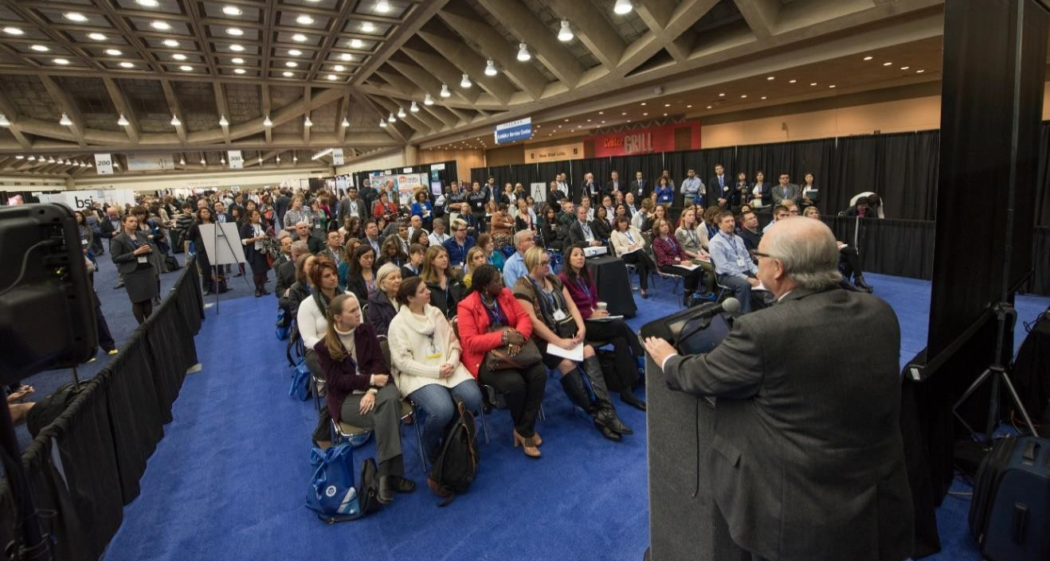
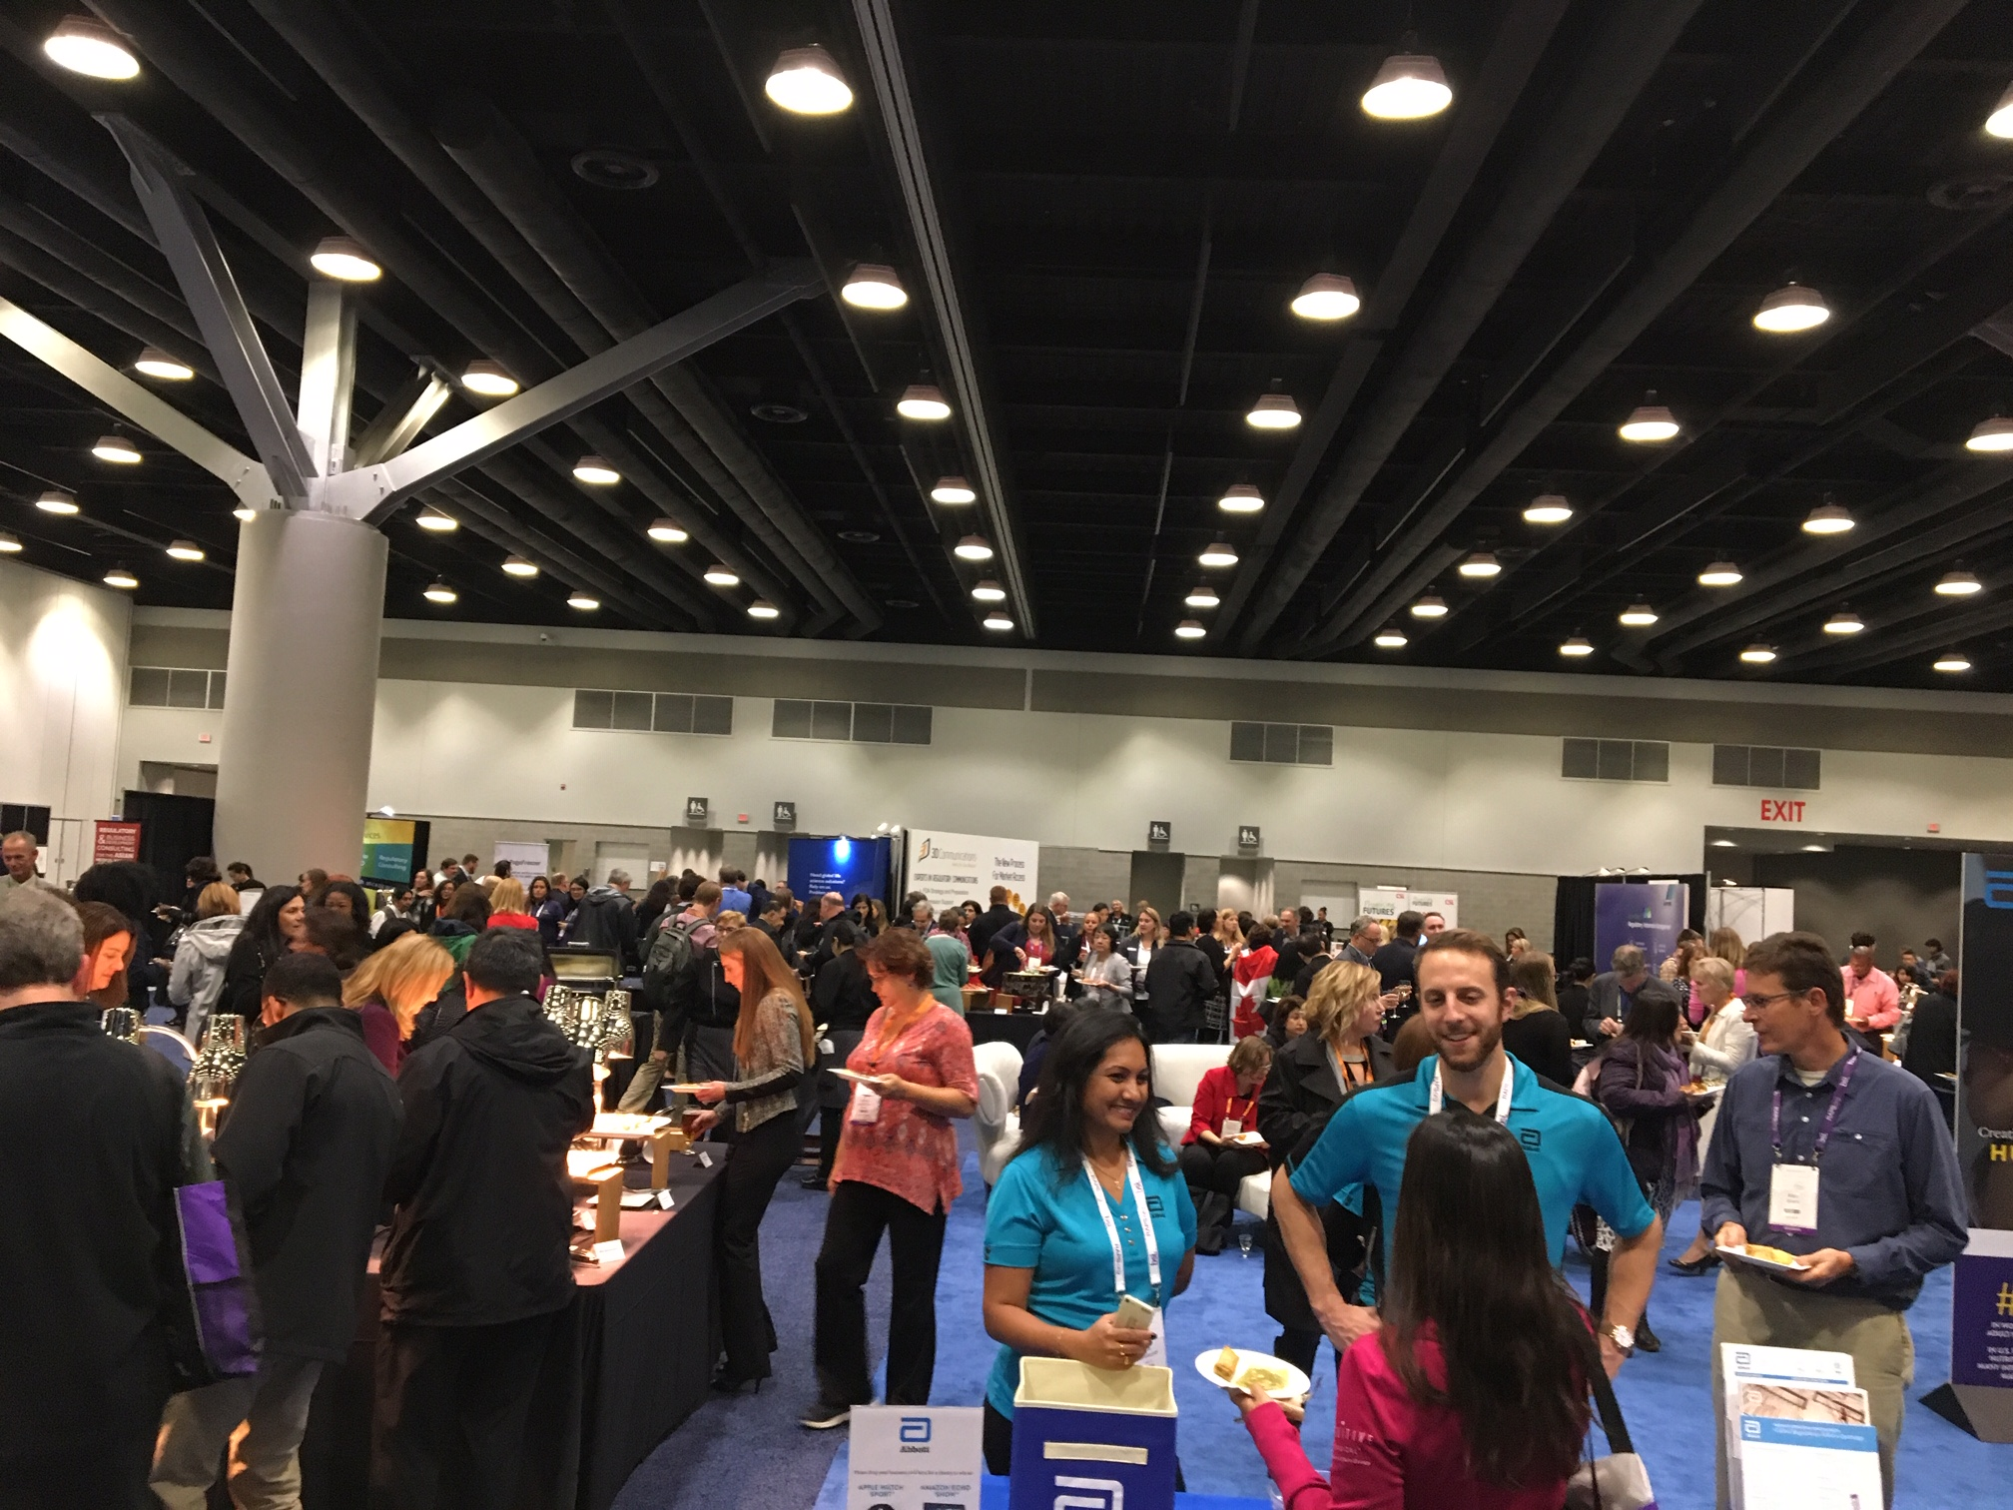
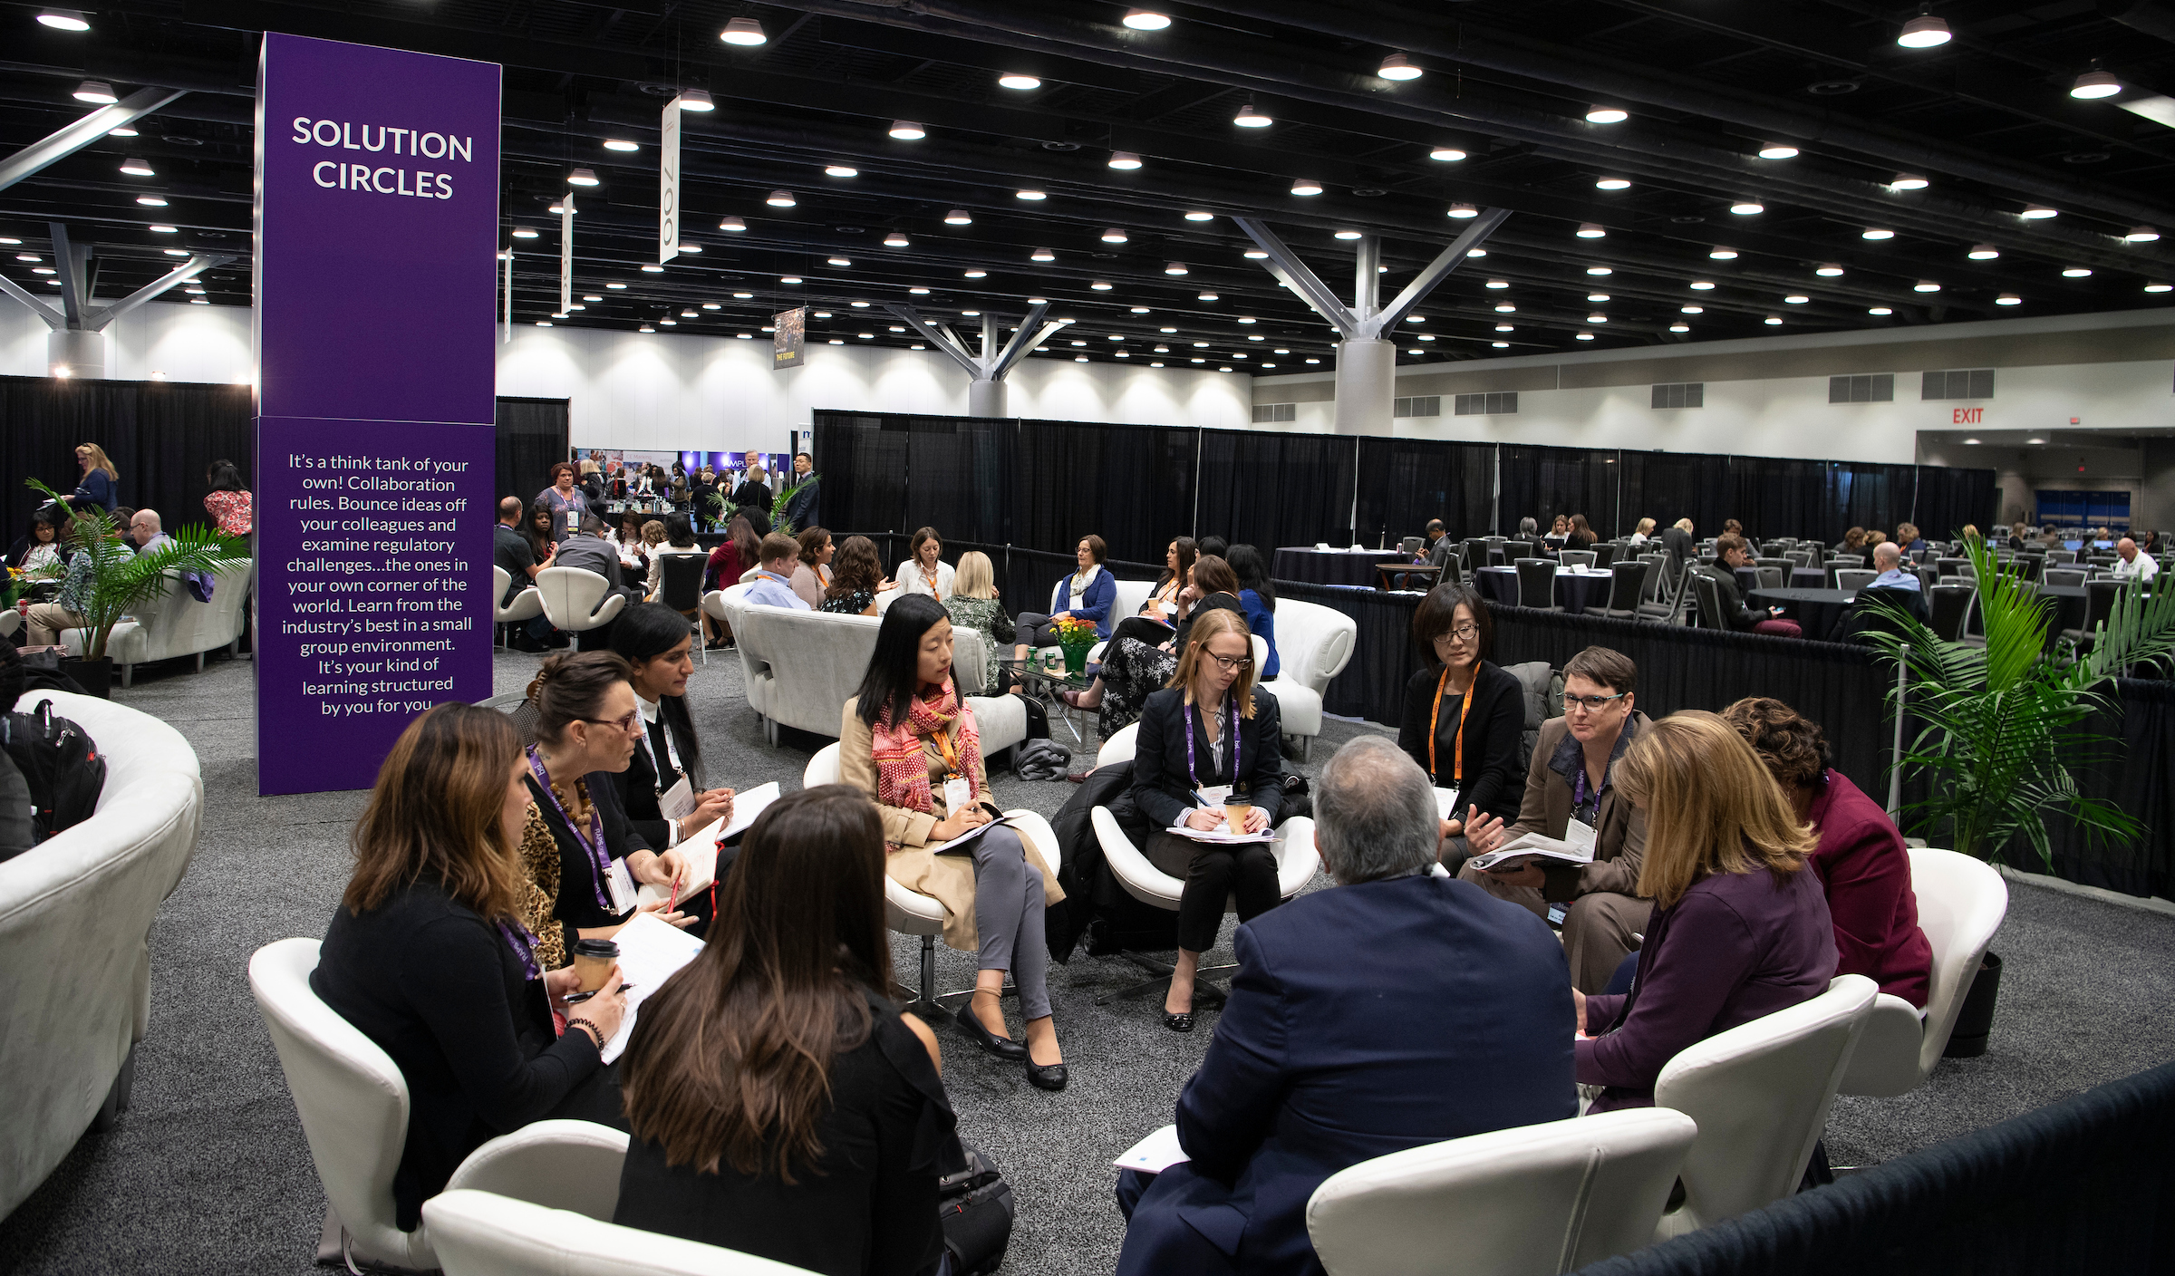
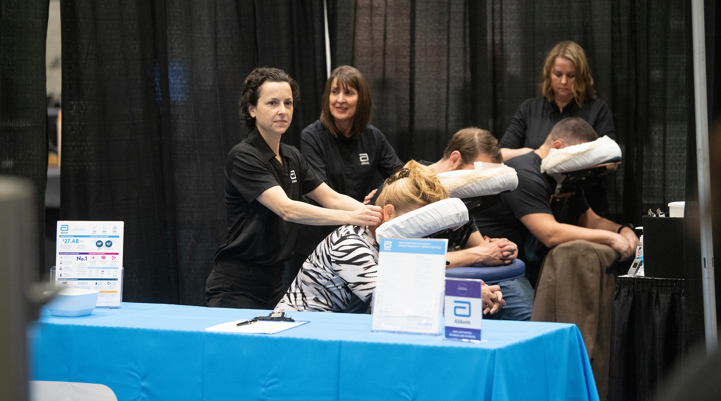

Slide 17
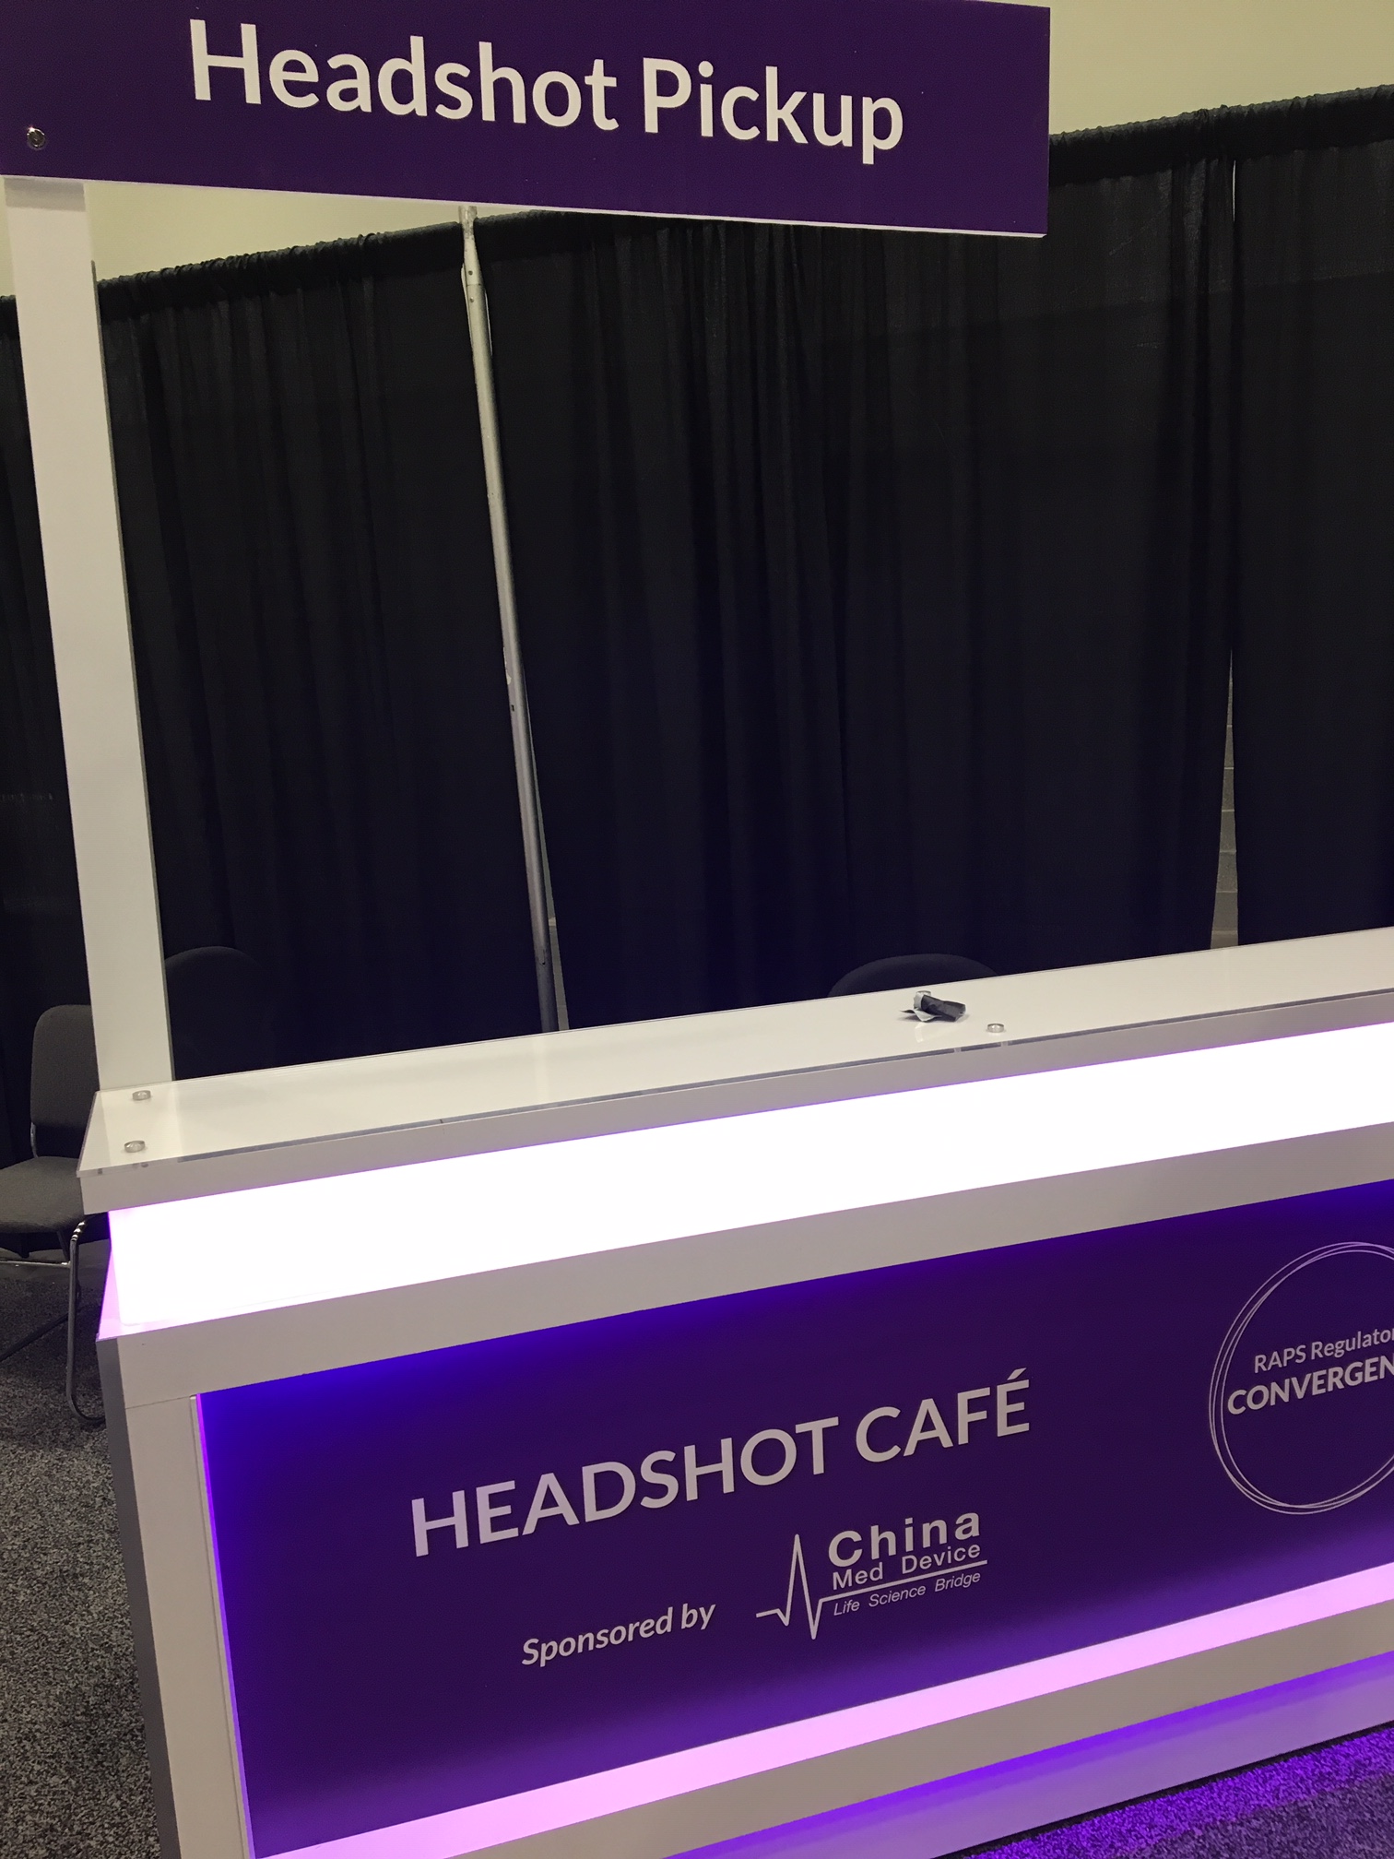

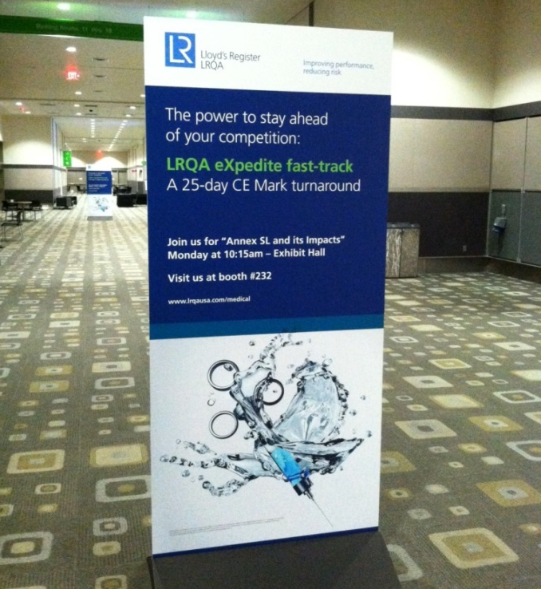
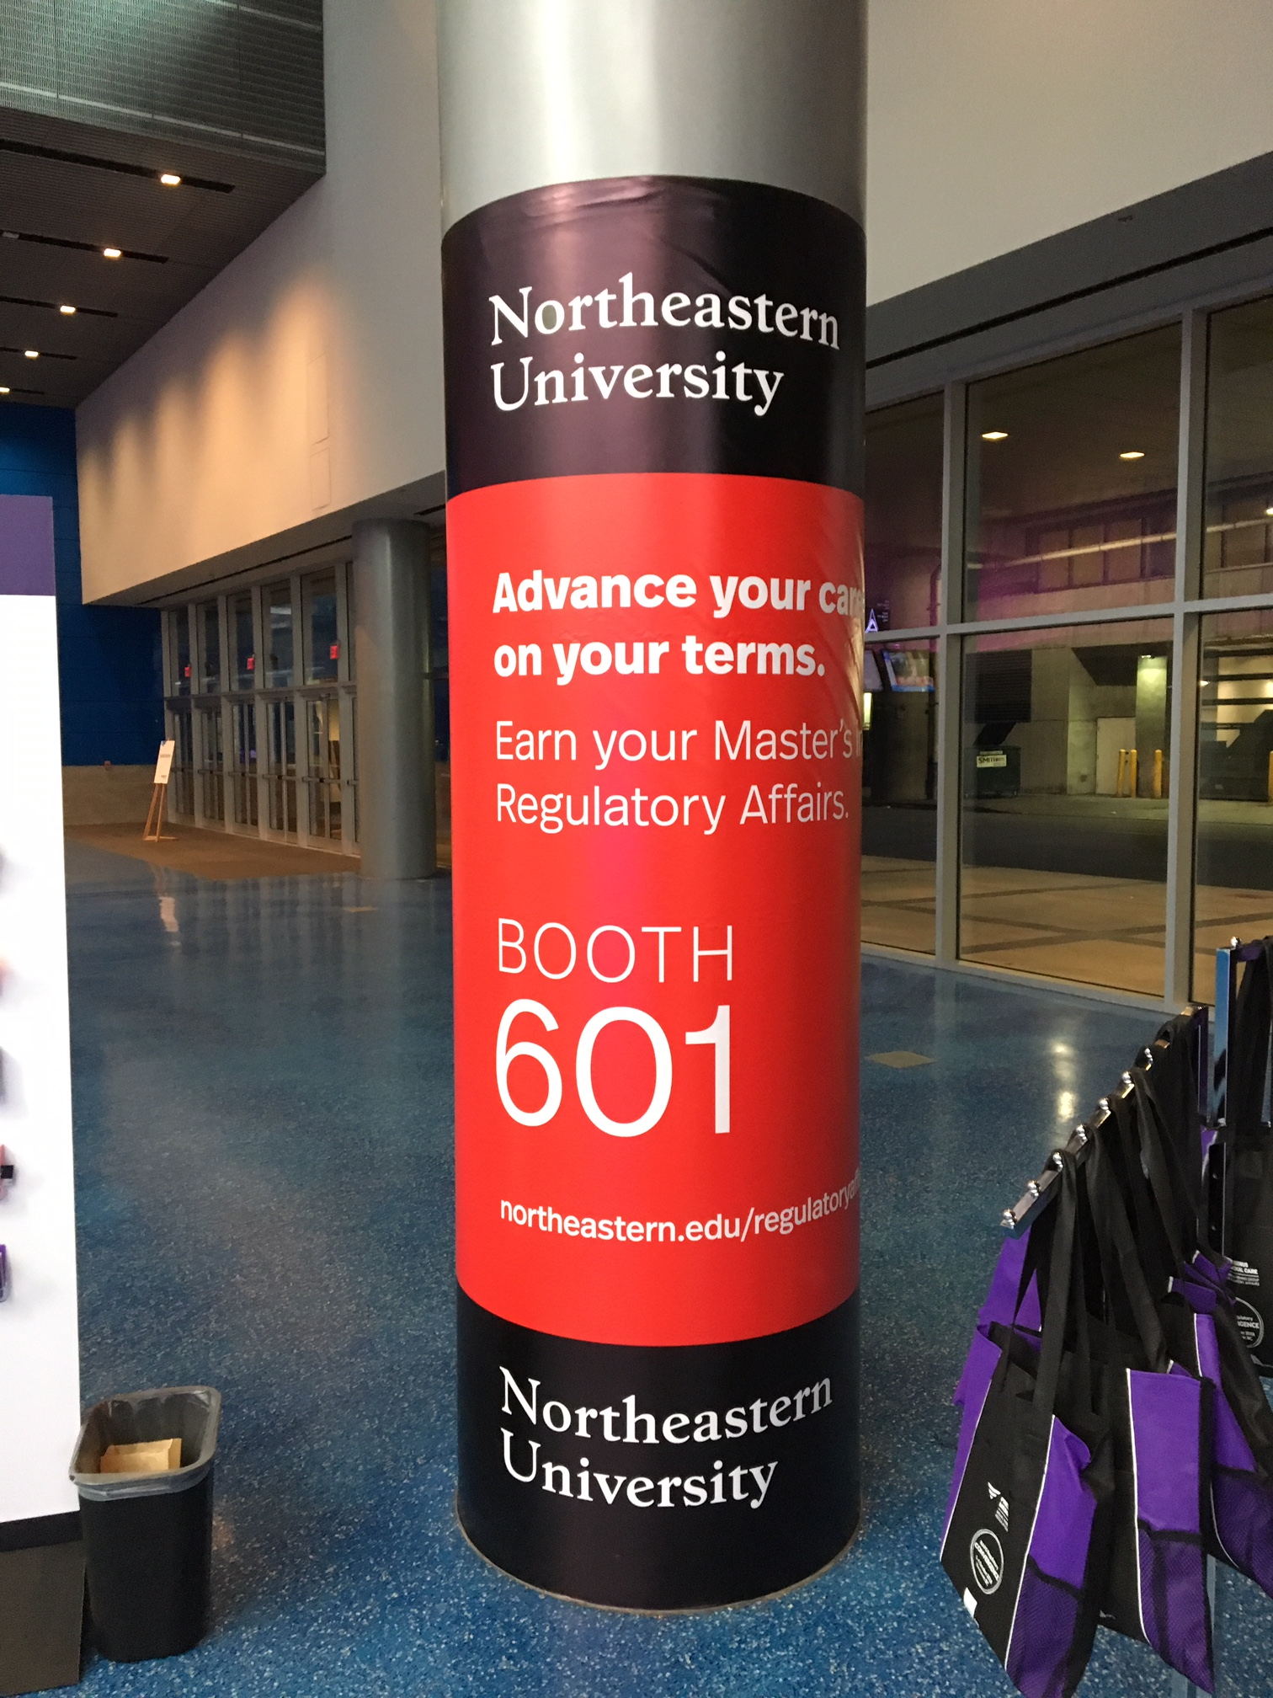

Slide 18
Exhibit Fees and Floorplan
Booth Size | Booth Fee | (Rate After 1 MAR)
2’x 6' Tabletop | $2,800 | $3,000
10’x 10’ Inline | $3,800 | $4,100
10’x 10’ Corner | $4,000 | $4,200
10’x 20’ Inline | $6,700 | $7,000
10’x 20’ Corner | $7,200 | $7,500
View the Virtual Floorplan for Availability

Slide 19
Additional Information
BOOTH LOCATION
Booth spaces are approved solely at the discretion of RAPS. RAPS is not responsible for booth assignments of competing companies.
BOOTH STAFFING
Booths must be staffed at all times during published Exhibit Hall hours. Early departure or absence will result in the company or group being penalized a fee no less than $2,500, a loss of priority points, and may result in being prohibited from participating in future RAPS events. It is understood that booths staffed by one individual will be vacant as necessary for breaks, meals, etc.
ADDITIONAL BADGES & LIMITS
All exhibit staff must have a badge to access the Exhibit Hall. Companies can purchase additional badges; full conference badges are $1,000 and exhibit hall only badges are $500. There is a limit to how many additional badges an exhibitor can purchase at those rates. Separate registration form is required. Contact Show Management at exhibits@raps.org for more information.
HOUSING AND TRAVEL
RAPS encourages you to book your hotel accommodations early. Rates will be available on the Convergence website at RAPS.org/Convergence.

Slide 20
Additional Information
ANCILLARY & SATELLITE MEETING SPACE
Limited space at RAPS’ official hotels may be made available for RAPS exhibitors for ancillary events. Events may not conflict with RAPS programming and are based on a first come, first served basis. Entertainment, meetings or similar activities will not be permitted in hotel rooms or other private or public facilities during hours that conflict with RAPS programming or sponsored events. Contract hotels will not reserve meeting rooms or function space for anyone during the meeting dates without prior approval from RAPS. Contact Show Management at exhibits@raps.org for more information.
Notes:
Combine as many of these slides as possible (19-22) and move to last)-decreasing size of text. Treat this as a disclaimer slide. You won’t be reviewing this during a typical sales pitch.

Slide 21
Exhibitor and Sponsor Timeline
March 2019
Final payment due for booths pre-selected at Convergence
Reduced booth fee deadline
May 2019 - Booth cancellation deadline
June 2019 - Company description deadline
July 2019 - Ancillary space request deadline
September 2019
Sunday, 22 September – move in day; hall opens at 5:45 pm
Tuesday, 24 September – move out; hall closes at 4:00 pm
*All dates and times are subject to change.
Notes:
Timeline graphic

Slide 22
Contact Us
Exhibits/Sponsorships
Leslie LeGrande, RAPS Sales Executive
+1 301 770 2920, ext. 221
exhibits@raps.org
llegrande@raps.org
Program Advertising
Tabbetha Marron
Account Executive, MCI | USA
+1 410 584 1989
tabbetha.marron@mci-group.com

