Slide 1



Slide 2
Design and Additive Manufacturing of Continuous Fiber Isogrid Structures
Continuous Composites Inc.

Slide 3

SPEAKERS
Nathan Stranberg
Director of Application Engineering

Slide 4
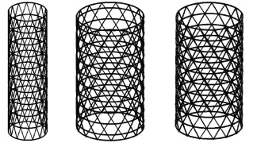
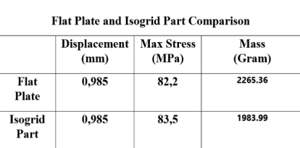
Isogrids and Applications
  Isogrid is a lattice of stiffening ribs forming an array of contiguous equilateral traingles¹
  Applications:
  Transport Airplane: Isogrids reduced fuselage structural depth from 4 inches to 1.5 inches¹
  Composite Fairing: Isogrid design reduced weight by over 40%²
  Isogrid Tube: Isogrid designs reduced at least 45% of mass³
  Payload Shroud: Isogrid resulted in a 61% reduction in weight, 300% strength increase, and 1000% stiffness increase over the existing aluminum design⁴
  Why aren’t isogrids not more prevalent today?
1 Isogrid Design Handbook
2 Application of advanced grid-stiffened structures technology to the minotaur payload fairing
3 Design Optimization and Development of Tubular Isogrid Composites Tubes for Lower Limb Prosthesis
4 Advanced Grid Stiffened Composite Structures

Slide 5
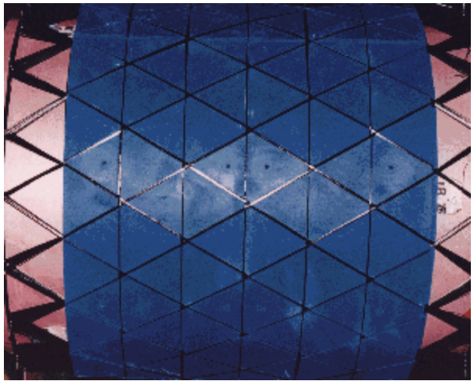

Isogrid Manufacturing Evolution
  Isogrids were first invented in the 1950s and were machined out of aluminum billet^{5,6}
  Composite materials are higher performing than aluminum materials
    Composites see over 13X increase in specific strength over aluminum¹²
    Composites see over 3.5X increase in specific stiffness over aluminum¹³
  In the 1990s, the Air Force set out to achieve the first high quality composite isogrid structure
    Combined the geometrical advantages of isogrids with the material advantages of composites
    While successful, the manufacturing method was very labor intensive and was limited primarily to cylindrical structures⁷
5 EVOLUTION IN MANUFACTURING OF GRID STIFFENED STRUCTURES THROUGH CAM AND ADDITIVE TECHNIQUES
6 Advanced Grid Stiffened Composites
7 Grid Stiffened Structures: A Survey of Fabrication, Analysis and Design Methods
8 Design and manufacturing of an isogrid structure in composite material: Numerical and experimental results

Slide 6
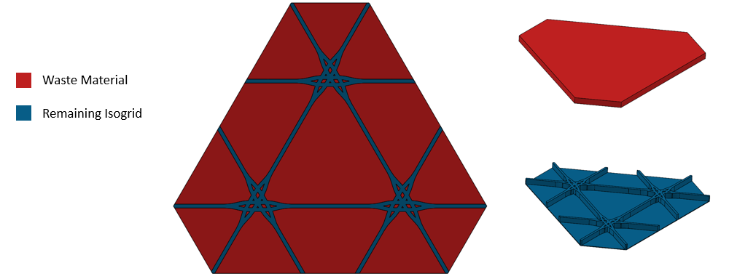
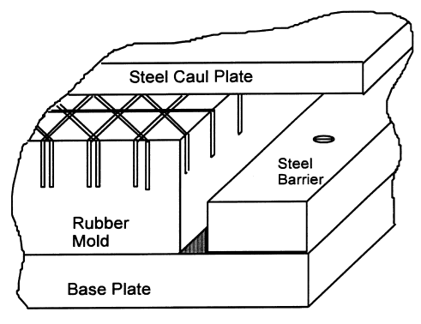
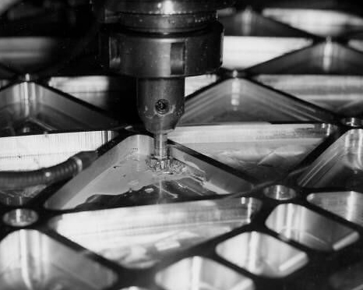
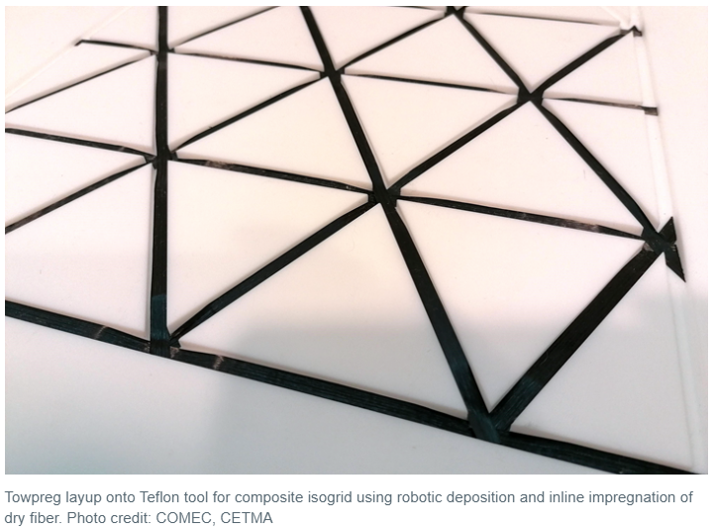
Isogrid Manufacturing Today
  The most common method of manufacturing is mechanical and chemical milling processes (2021)⁹
    Milling results in the distortion of the isogrid ribs and is limited to certain geometries⁹
    For a 1m triangular isogrid panel with ~500mm node-node length and 14mm rib width, conventional manufacturing results in ~80% waste
  Current automated composite approaches utilize costly hybrid tooling with machined grooves to form the isogrids¹⁰
    Stresses rise over 50% during the cooling phase due to the CTE mismatch of fiber, matrix, and mold material¹¹
  What is needed is a different way of manufacturing isogrids
    Reduced waste, design flexibility, minimal tooling
9 EVOLUTION IN MANUFACTURING OF GRID STIFFENED STRUCTURES THROUGH CAM AND ADDITIVE TECHNIQUES
10 Development of composite isogrid structures using innovative deposition technology
11 Design and manufacturing of an isogrid structure in composite material: Numerical and experimental results

Slide 7
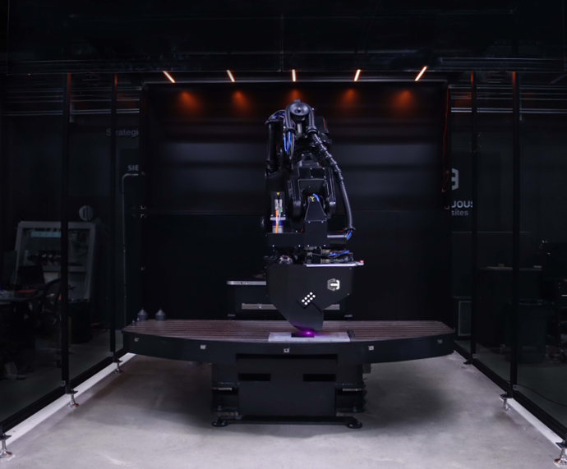
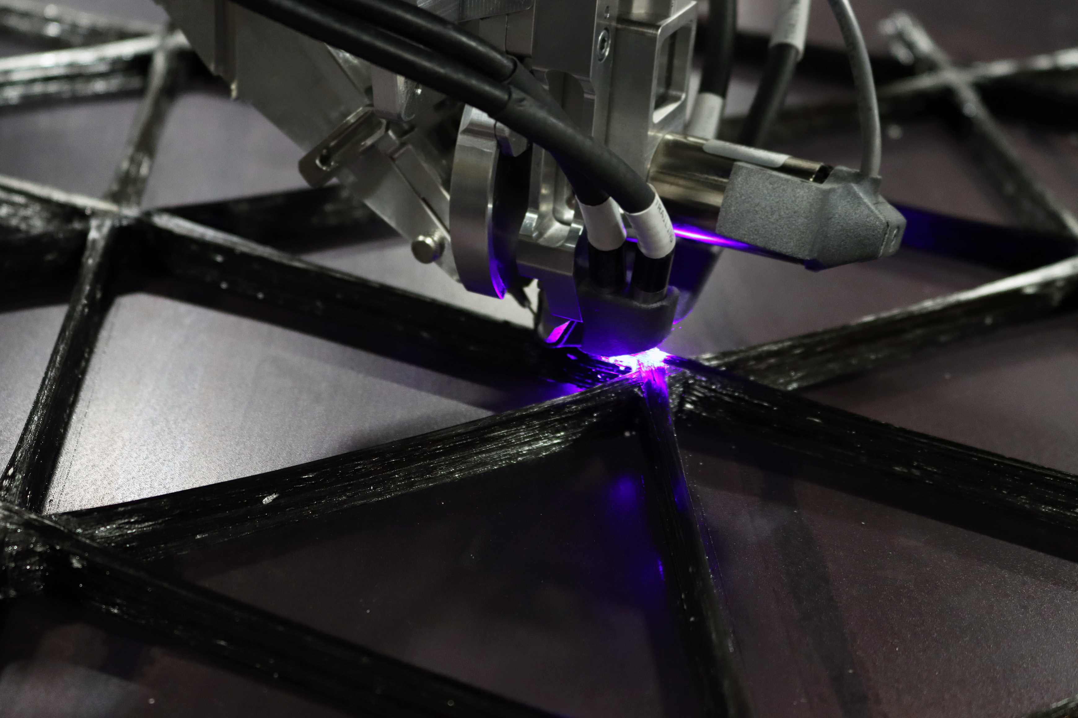
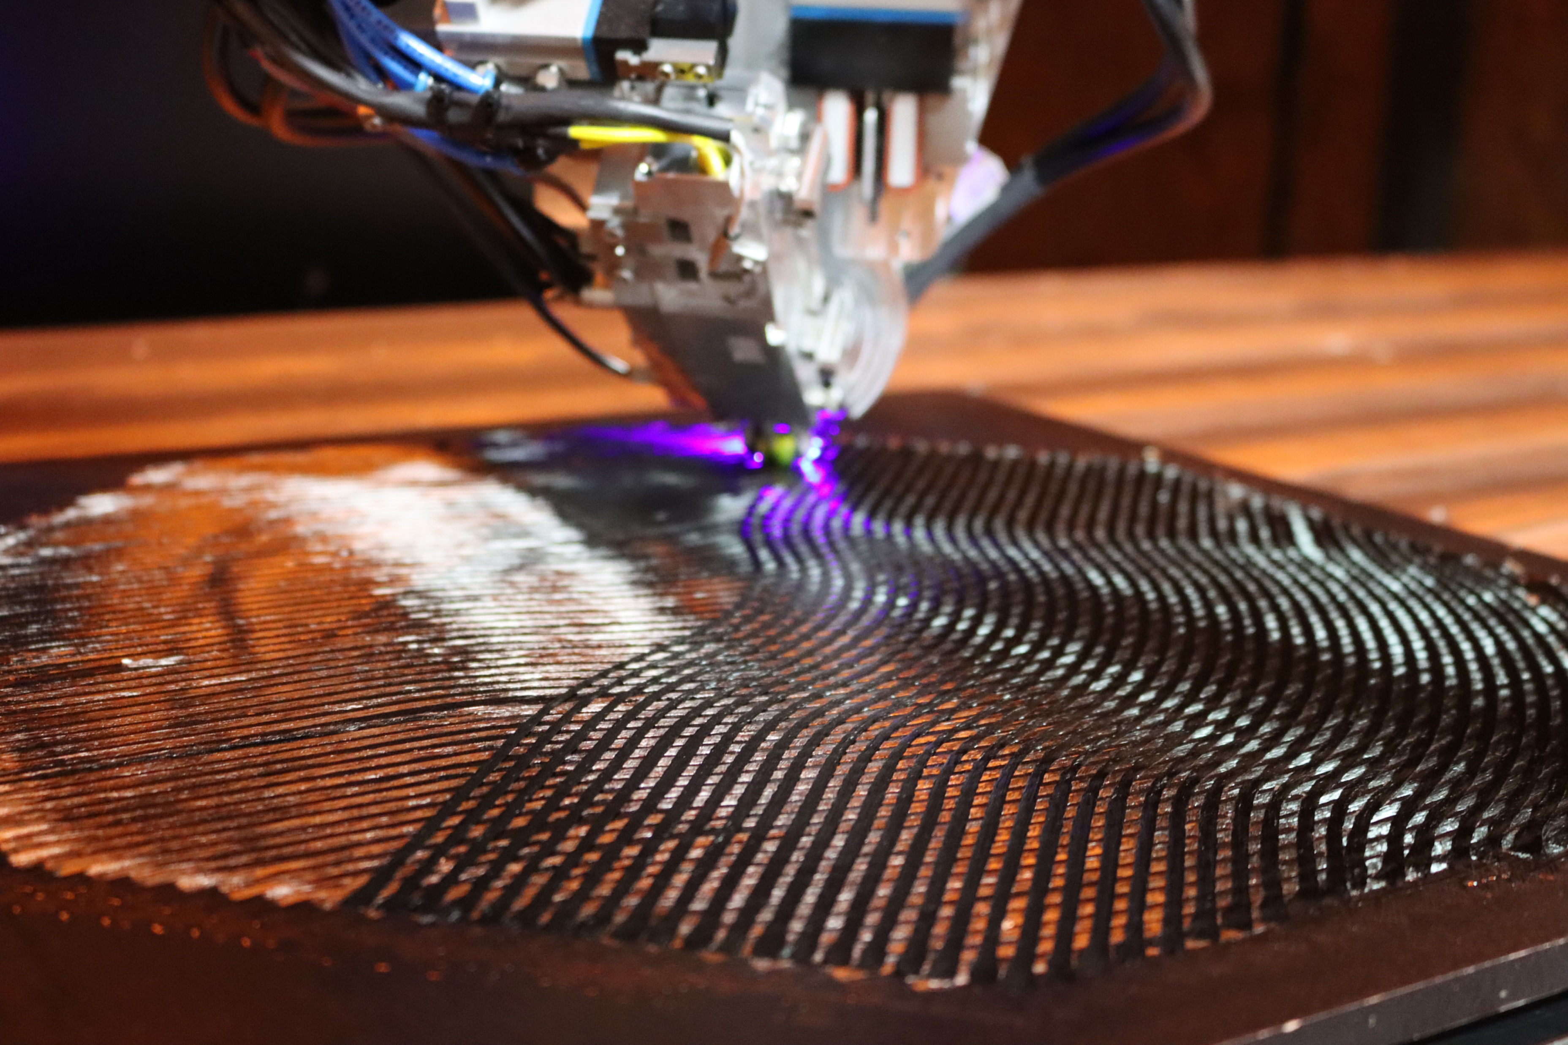
Next Generation Isogrid Manufacturing
  CF3D® (Continuous Fiber 3D) Manufacturing combines the advantages of composite materials and 3D printing
  CF3D® Manufacturing enables next generation composite isogrid manufacturing through:
    In situ impregnation of a liquid thermoset polymer (opposed to b-staged prepreg)
    In situ consolidation and curing
    High-accuracy robotics
    Tow-level design
    Advanced path planning

Slide 8
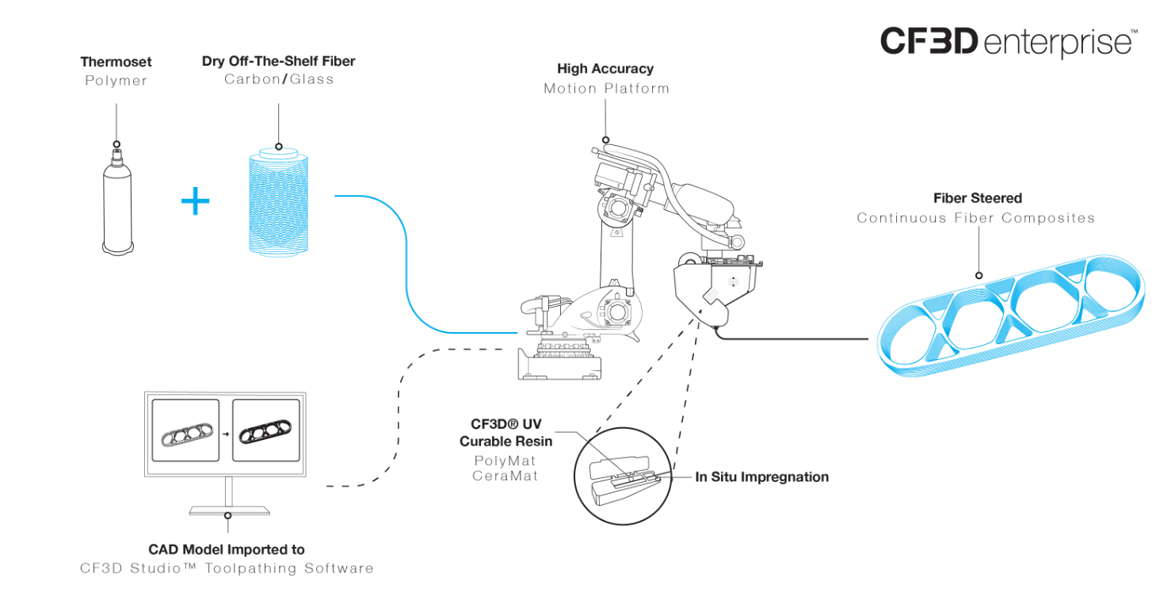
CF3D® Process Design

Slide 9
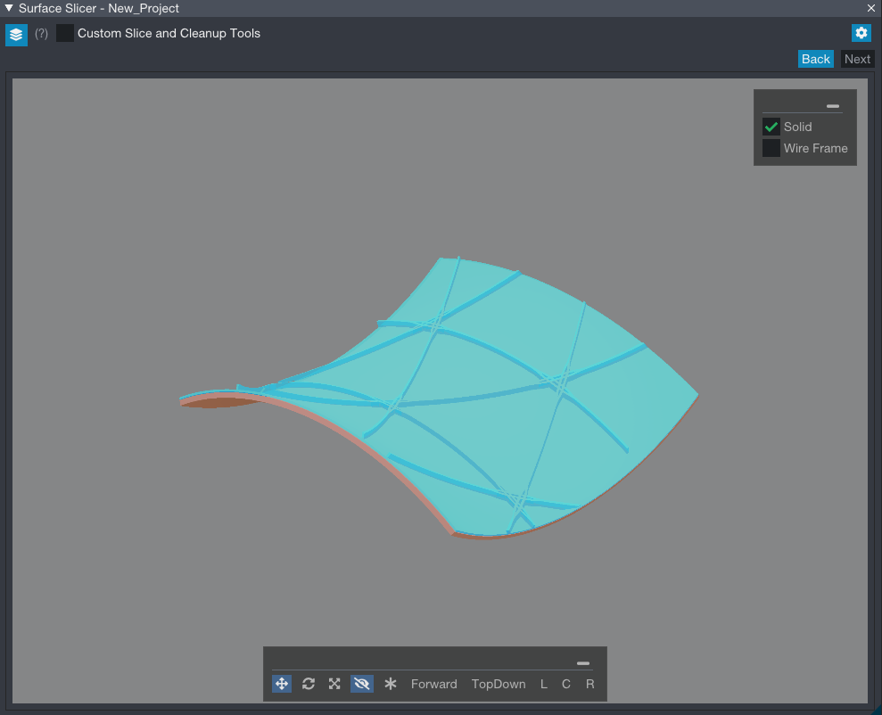
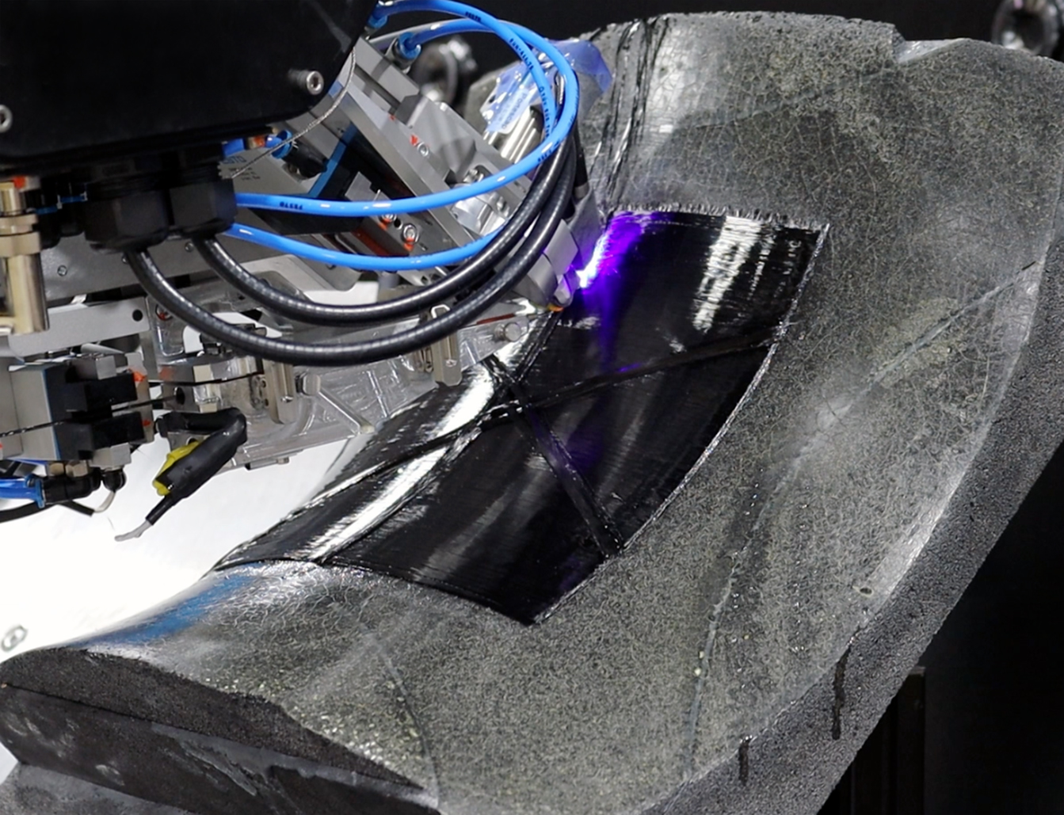
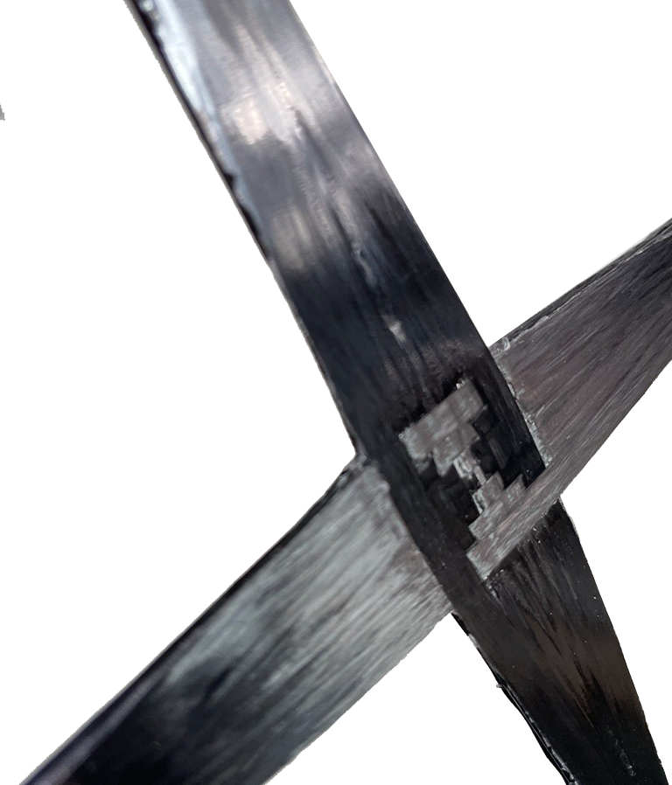
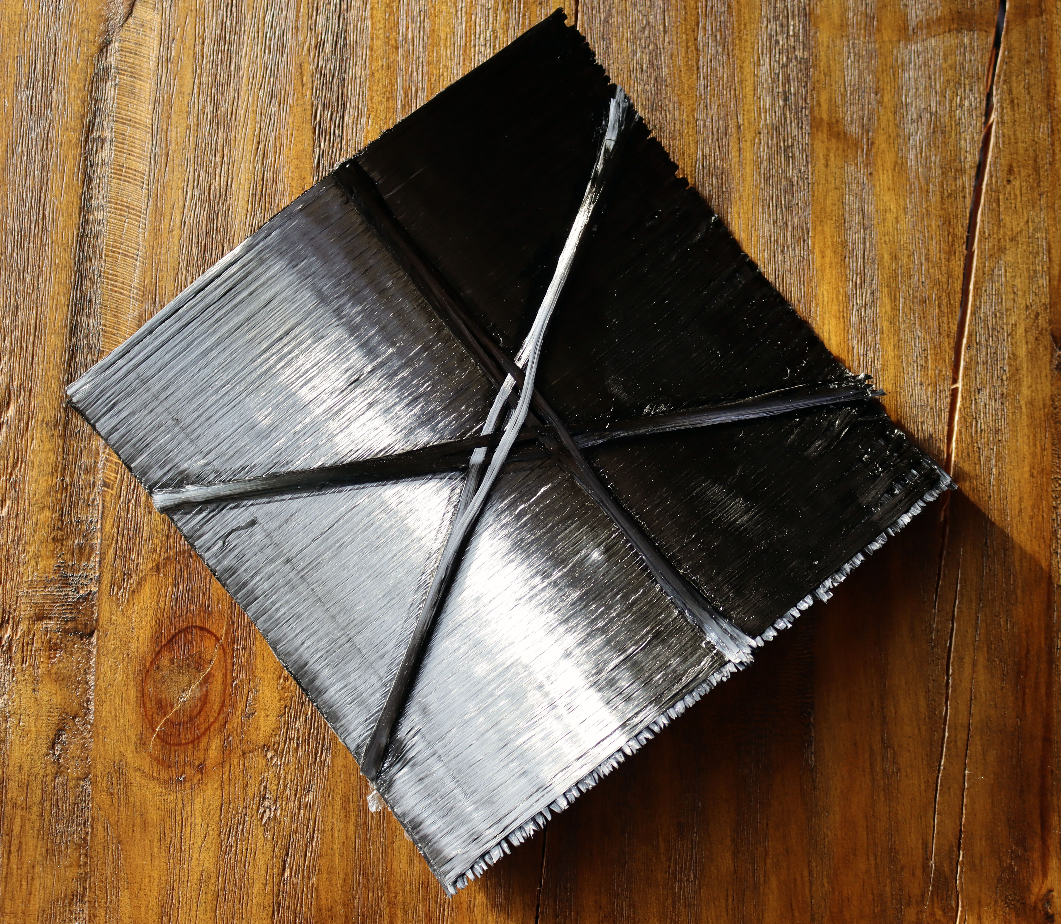
CF3D® Isogrid Manufacturing Advantages
  Net shape printing equates to 0% waste compared to traditional ~80% waste
  In situ curing enables composite isogrid manufacturing without hybrid tooling
  Tow level design aligns the fibers in the rib directions
  Fiber steering enables continuous fiber intersections with no undesirable Z buildup
  Robotics enable off axis isogrids manufacturing over double curved surfaces without wrinkling or puckering

Slide 10
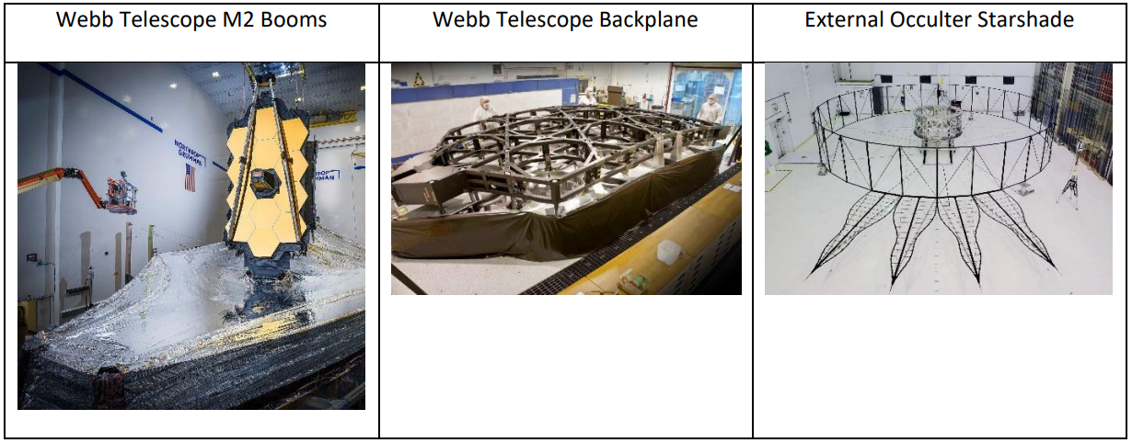
NASA Isogrid Case Study
  NASA has recognized the need to push the state of the art in current optomechanical technologies¹²
  Important Factors:
  Dimensional stability
  Temperature
  Manufacturability
  Cost
  Example Structures:
  Optical benches
  Stable optics
  Metering structures
  CCI and NASA are working together to demonstrate CF3D® dimensionally stable structures for future space astronomy missions
12 SBIR.gov Topic S12.02

Slide 11
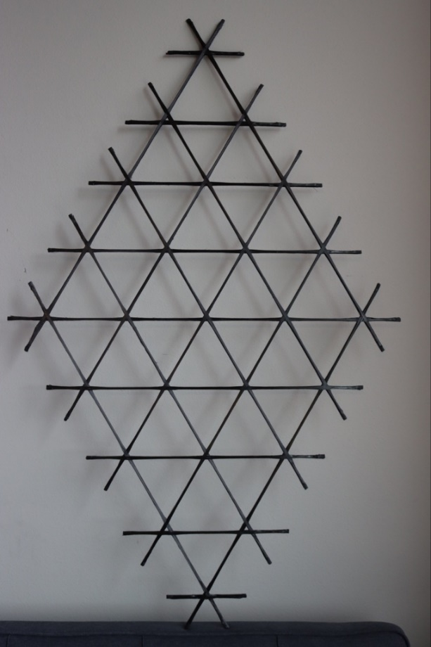
Continuous Fiber Isogrid
  Dimensionally stable structure design: CF3D® isogrid
    High stiffness to weight ratio combining isogrids and composites
    Continuous fiber lug elements attachment points
    Dimensionally stable with temperature change
  Phase I SBIR Demonstration:
    Design, toolpath, and printed an isogrid structure
    Predicted mechanical performance with refined FEA models
    Achieved near-zero coefficient of thermal expansion

Slide 12
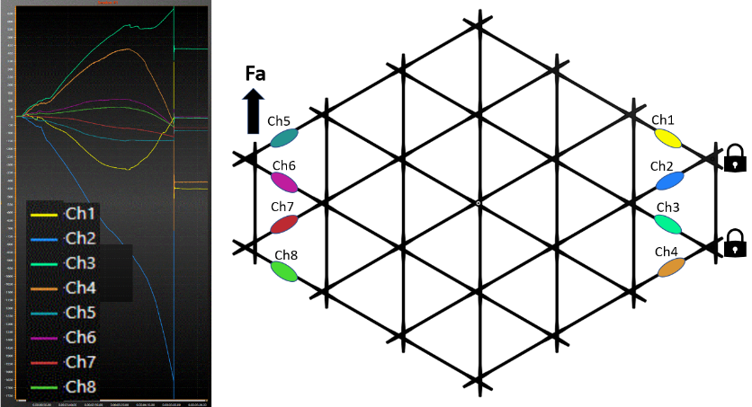
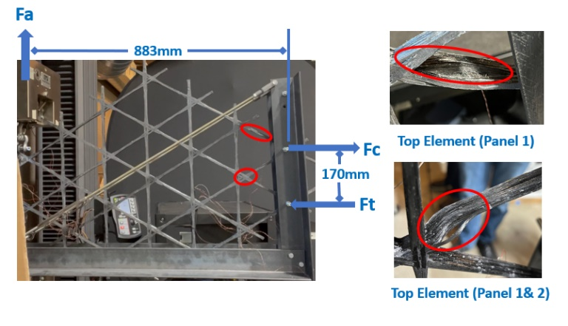
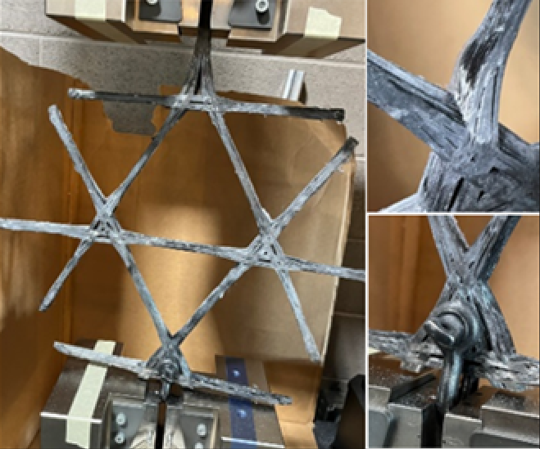
Isogrid Structural Performance and Modeling
  Sub-element testing to understand continuous fiber intersection performance
  FEA modeling predicted failing force of 2.0kN (441lb) at the intersection under compression loading
  The iso-grid panel tested under load failed at 2.01 kN (Fa)
  99.5% accurate to prediction using FEA model and experimental data at the sub-element level

Slide 13
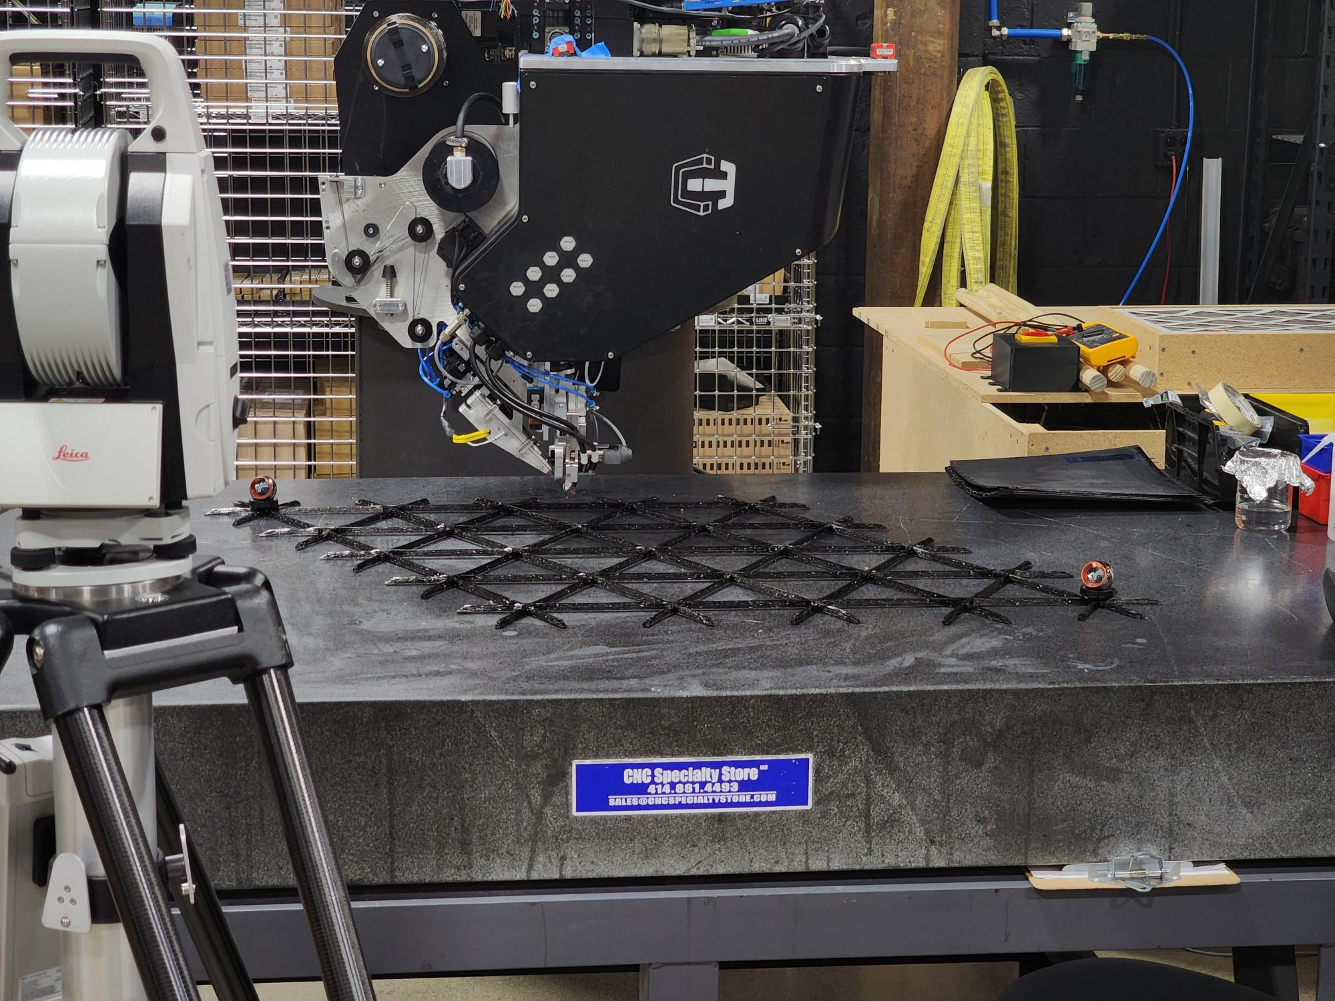
Isogrid Dimensional Stability
  Achieved -0.018 ppm/°C through coupon level testing
  Full scale isogrid (1300mm x 850mm) had a change in length of 0.42um/°C

Slide 14
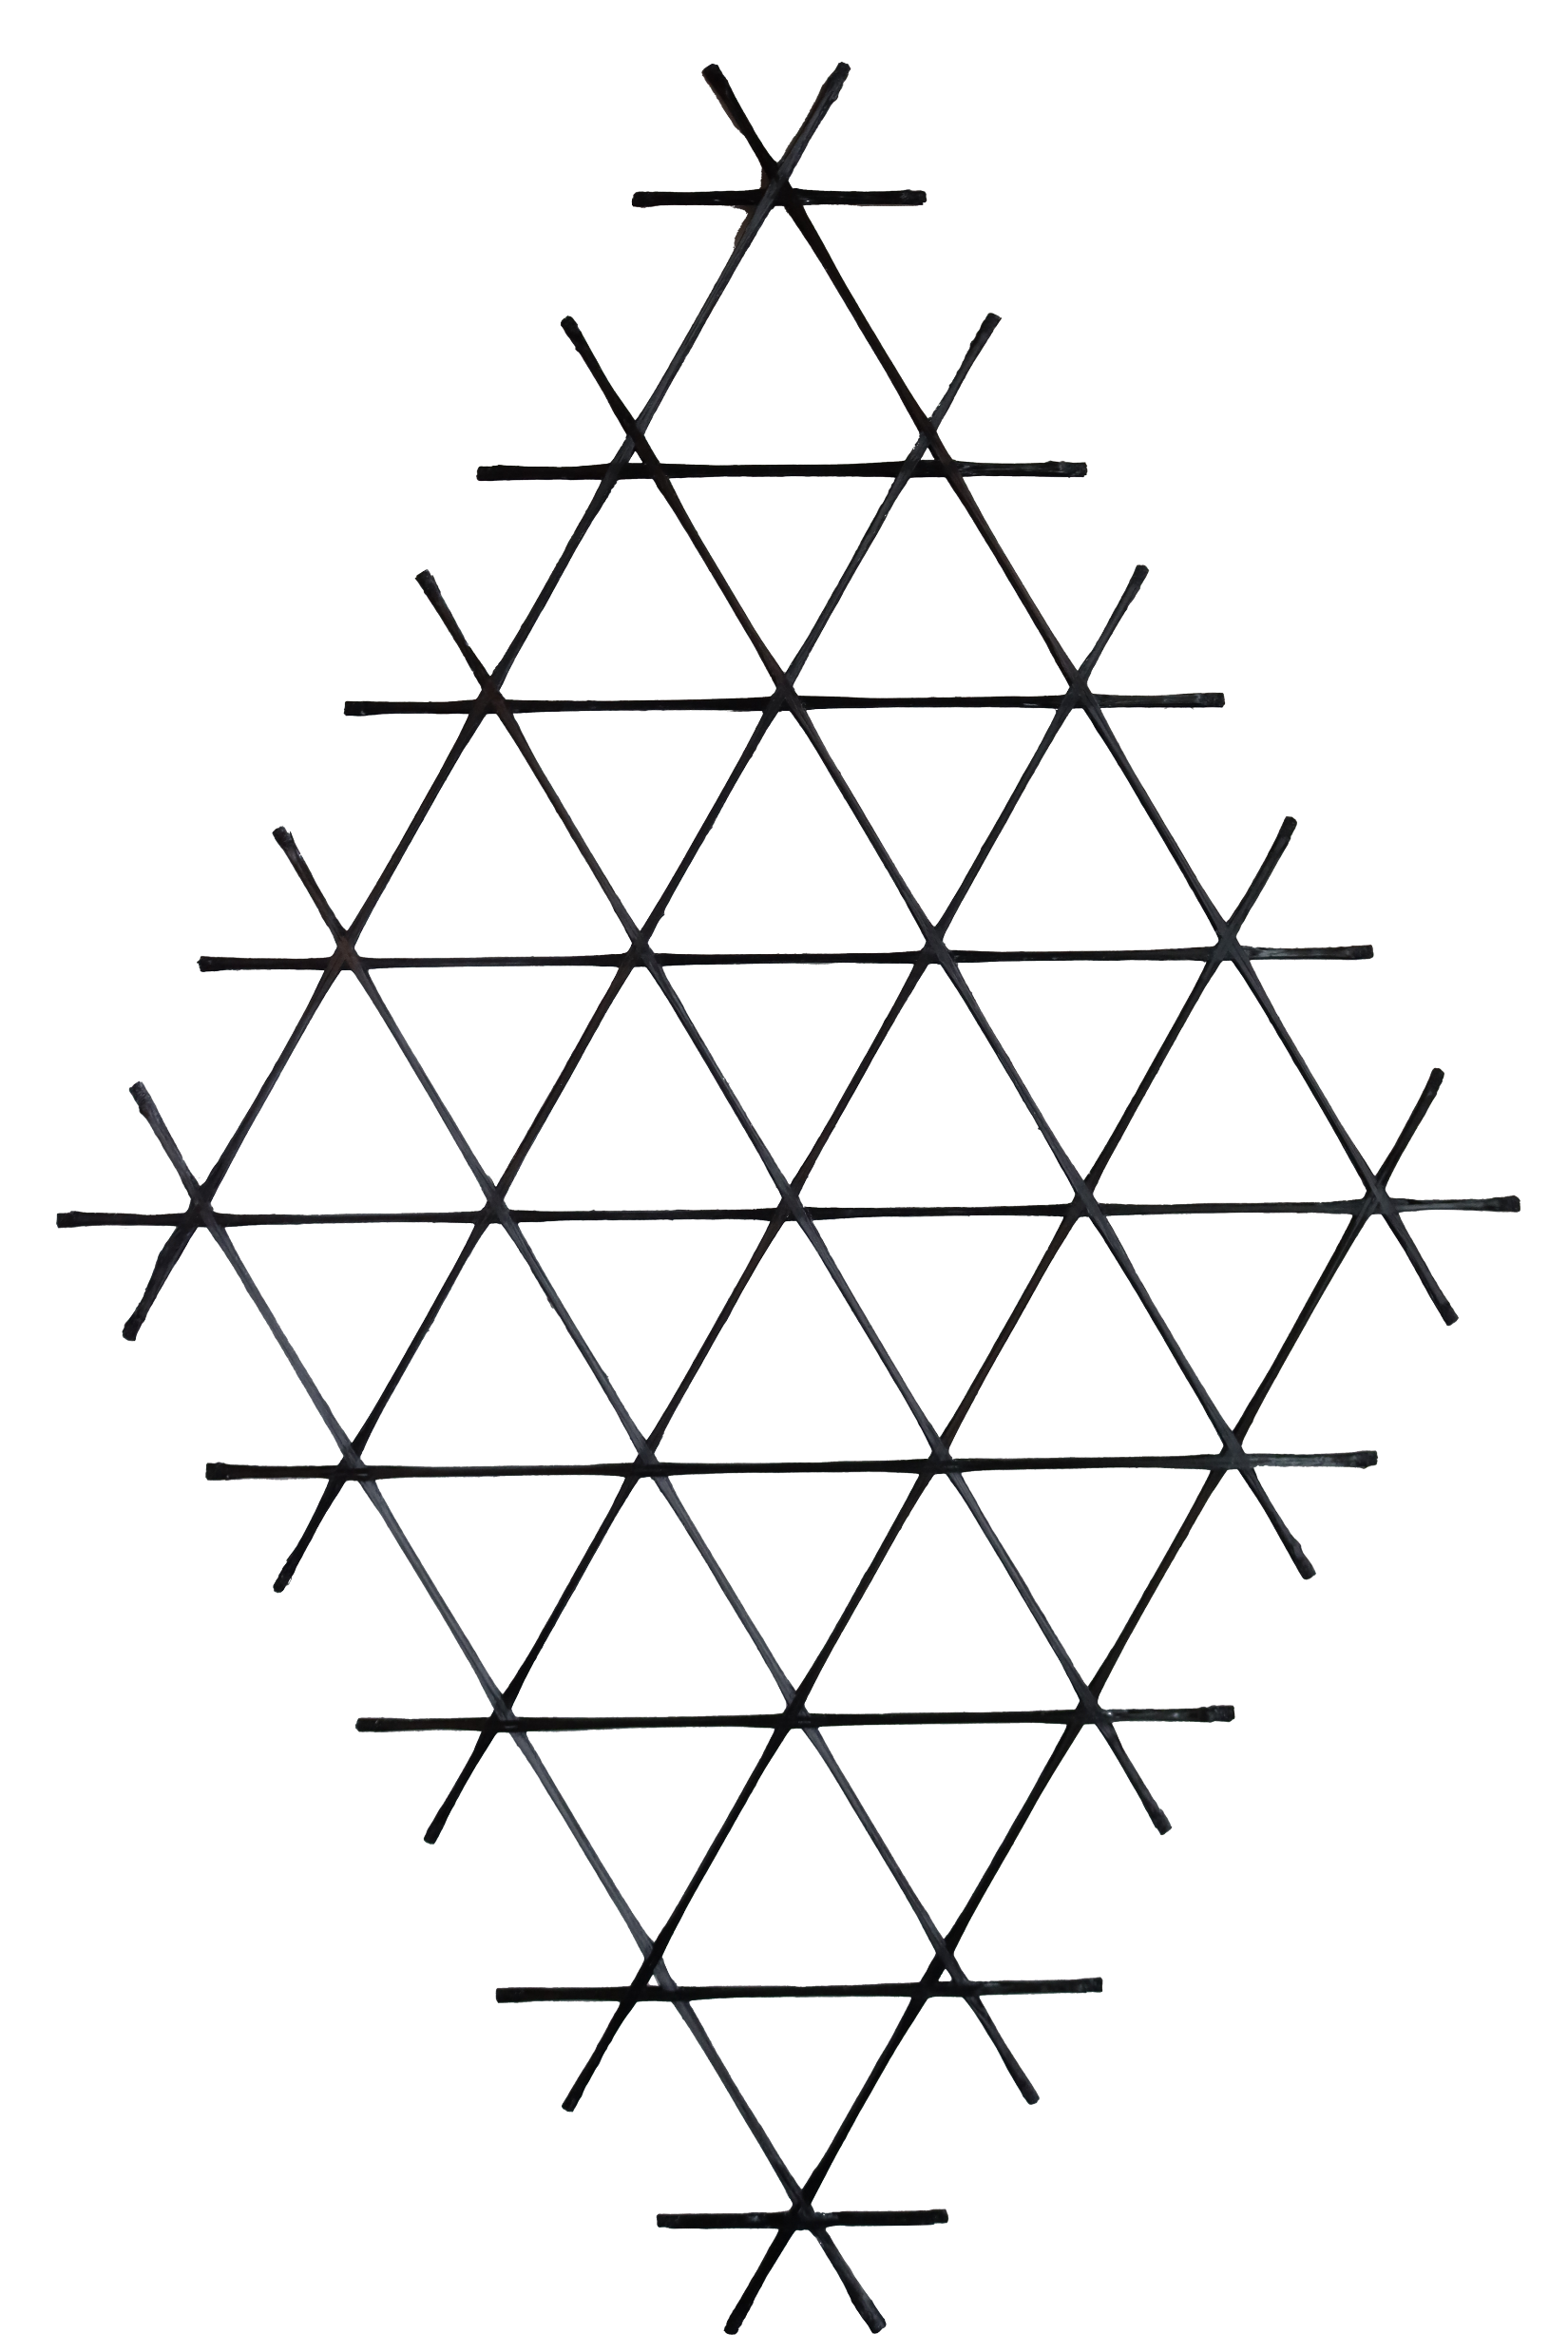
Conclusion
  Isogrids are a proven structure with high stiffness/strength to weight ratios
  Continuous fiber composites are superior to aluminum from a stiffness and strength to weight ratio
  Current manufacturing processes limit isogrids to high-end applications because of material waste and costly tooling
  CF3D® is an emerging technology for manufacturing continuous fiber structures such as isogrids
    Zero waste, design flexibility, no tooling, fiber alignment
  Continuous Composites and NASA are demonstrating low-CTE isogrids (-0.018 ppm/C) with high modeling accuracy (99.5%)
13 SBIR.gov Topic S12.02

Slide 15


THANK YOU!

